Slide 1

A Spatial Population Genetic Sim of B. glandula in Coos Bay
Alex Bangs – Kern-Ralph Co-Lab - July 2024

Slide 2
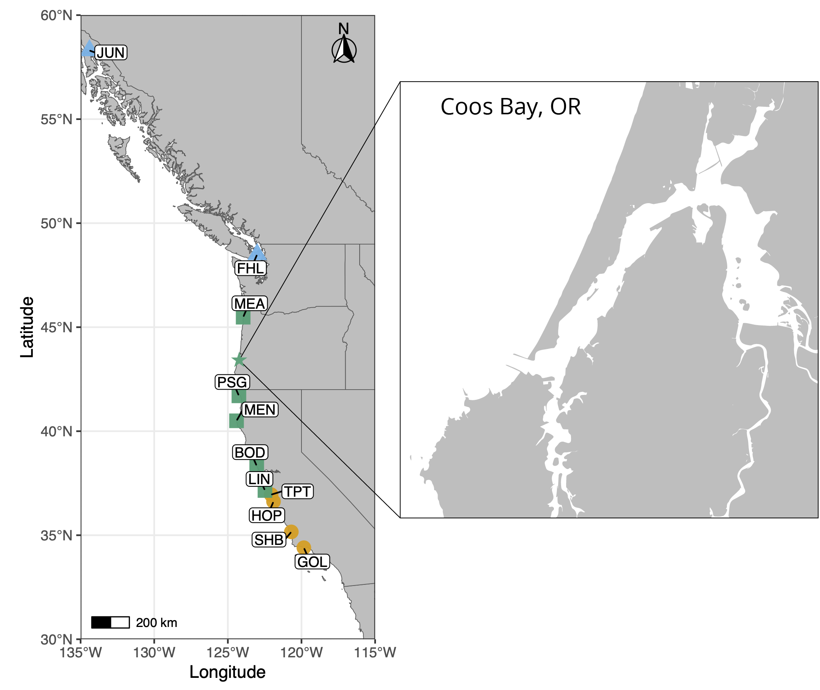
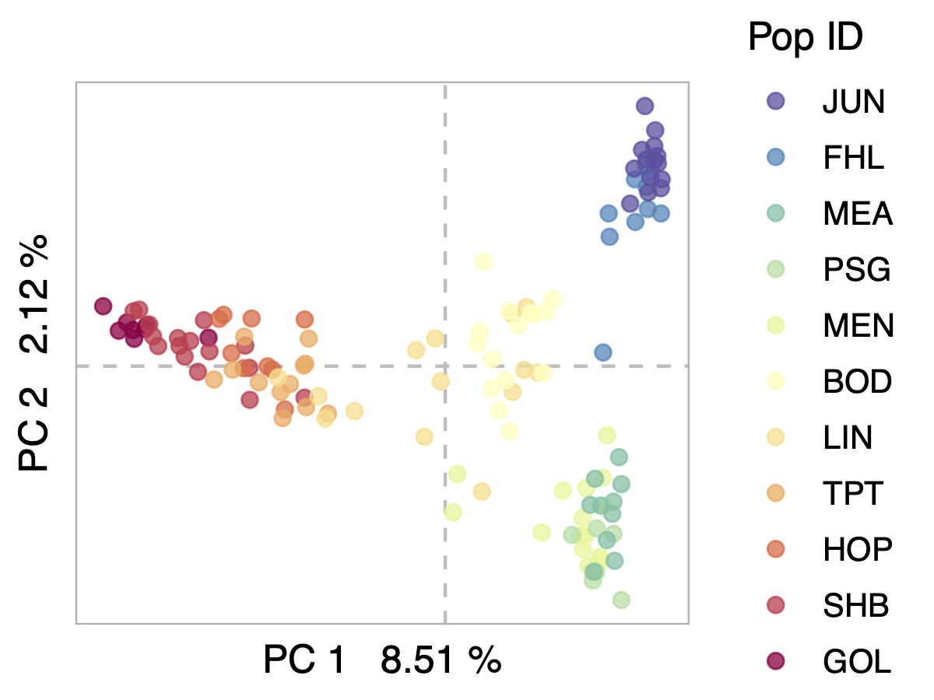
Introduction
Notes:
The lab is studying B. glandula because of how their unique life stages, biological factors, and relationship with their environment impact their population genomics
Simulations are a very powerful tool for studying population genomics, and help ensure our assumptions about B. glandula aren’t unfounded
The Pacific Coast vs Coos Bay

Slide 3



Building Coos Bay - Coastline

Slide 4
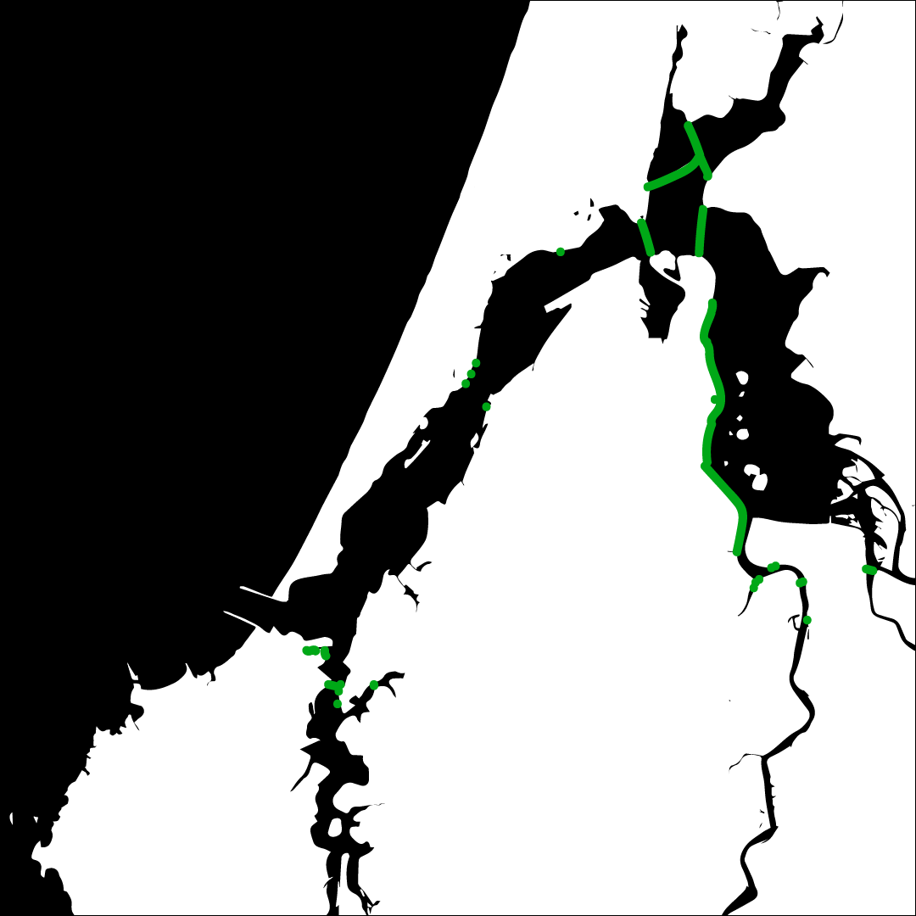
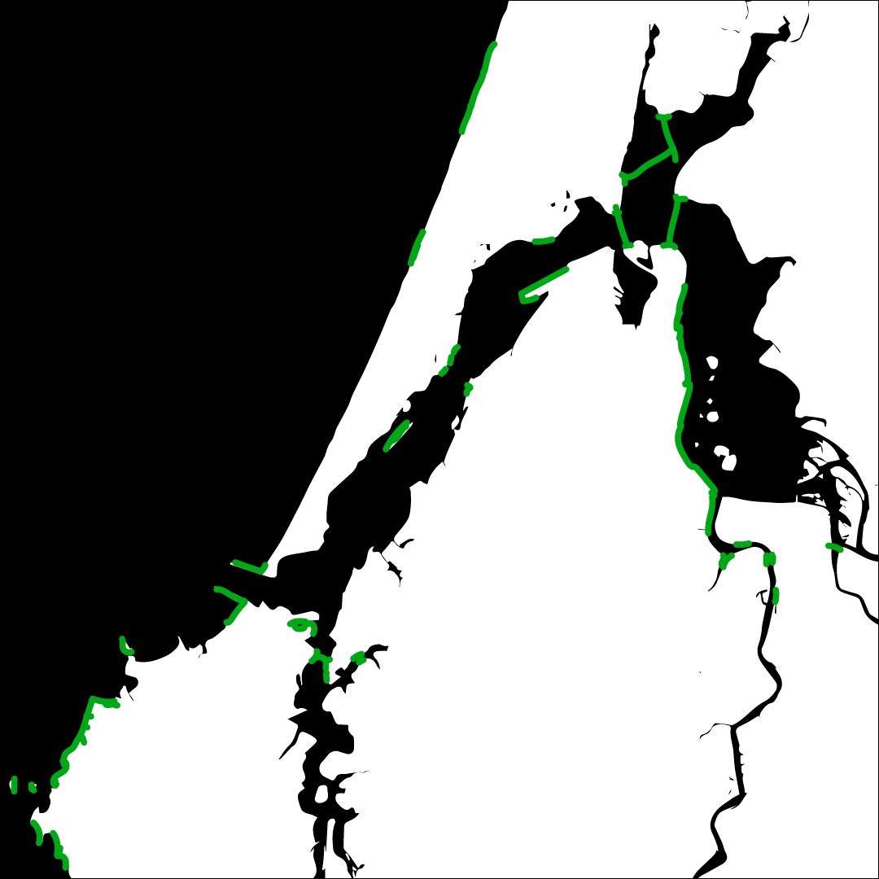

Building Coos Bay - Habitat
Habitat information from the personal observations of OIMB Director Craig Young

Slide 5
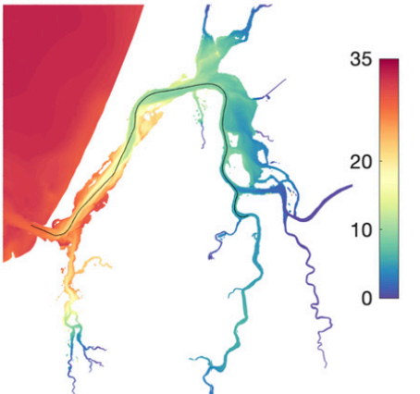


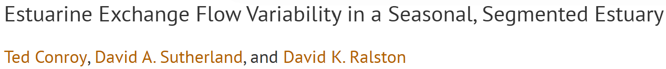
Building Coos Bay - Salinity
Salinity scale measured in PSU (g of salt/L of water)

Slide 6
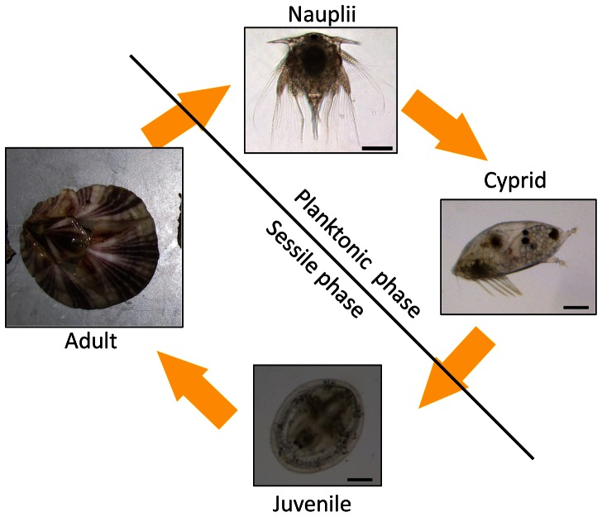
Barnacle Life Stages

Slide 7
Current Limitations and Next Steps
Dispersal distance using sampleNearbyPoint
Predation of adults not accounted for
Inclusion of Seasonal Salinity
Increasing carrying-capacity and running on Talapas
Diving deeper into TreeSeq and genomic analysis

Slide 8

Strategies for growth
Navigating the future

Slide 9
Current market analysis
We have identified important key trends that demand our attention.
Data reveals a steady increase in consumer demand for sustainable products, presenting an opportunity for our eco-friendly offerings.
Our competitors are now focusing on digital marketing strategies, suggesting a shift in consumer behavior.
Understanding these nuanced dynamics positions us to adapt and capitalize on emerging market preferences.

Slide 10
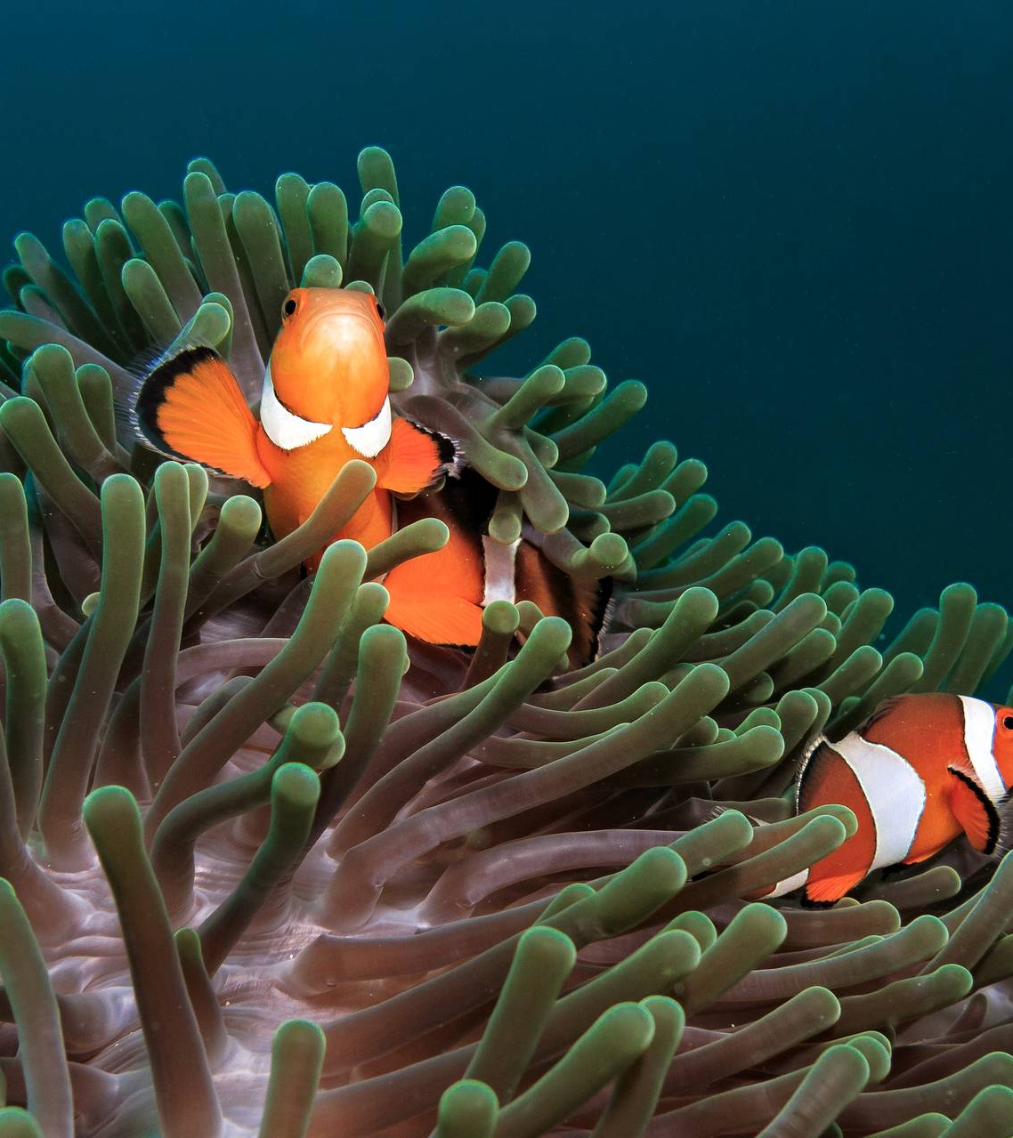
Market expansion
Unlocking new horizons

Slide 11
Product launch
Q3
Market research
Q4
Product development
Q1
User testing
Q2
Product launch
Currently gearing up for a ground-breaking launch
Our new offerings will captivate the market
Our marketing campaign will generate anticipation

Slide 12

Marketing strategies
Implement personalized engagement strategies
Tailor campaigns to resonate with specific demographics, fostering a sense of relevance and connection
Collaborate with influencers and thought leaders to amplify our brand message

Slide 13
Financial overview
Our financial overview reflects a robust and resilient fiscal performance.
Key indicators show consistent revenue growth over the past quarter, attributed to strategic cost management and successful marketing.
Operating margins have improved, signaling operational efficiency, while strengthening our reserves.
This underscores our commitment to financial stability, positioning us for sustained growth.

Slide 14
Quarterly targets
Market expansion
Product innovation
Customer retention
Operational efficiency
Quarter | Revenue growth (%) | Market share increase (%) | Customer acquisition
Q1 | 12 | 2 | 500
Q2 | 15 | 3 | 600
Q3 | 18 | 4 | 700
Q4 | 20 | 5 | 800

Slide 15
Financial snapshot
Metric | Current value | Previous quarter | Change (%)
Revenue | $2,500,000 | $2,200,000 | +14%
Operating expenses | $1,200,000 | $1,400,000 | -14%
Net profit | $1,000,000 | $800,000 | +25%
Operating margin | 40% | 36% | +4%
Cash reserves | $5,000,000 | $4,500,000 | +11%

Slide 16

Innovative solutions

Slide 17
Future initiatives
Product enhancement. Introduce regular updates and features to enhance product offerings.
Technology integration. Explore emerging technologies for potential integration into our operations.
Collaborative partnerships. Foster collaborations with tech innovators and industry leaders to drive innovation.
Green supply chain
Reduced carbon footprint
Waste reduction
Water conservation

Slide 18

THANK YOU
Devon Torres
devon@contoso.com
www.contoso.com

